Slide 1
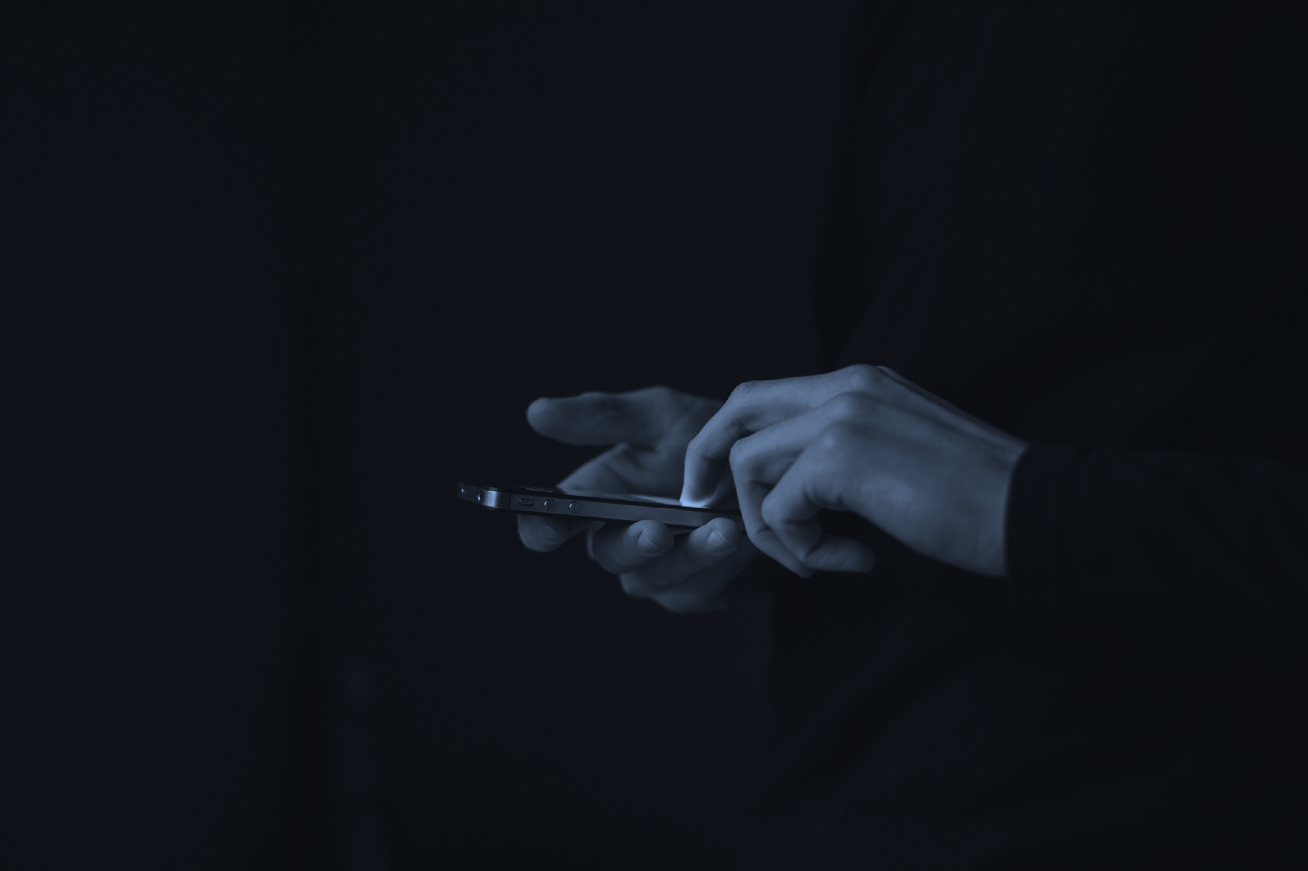
The Ethics of Communicating Via Text
Managing Communications Liability
July 18, 2019. MCLE
Credit: 1.0

Slide 2
Presenters
David M. Buddingh, President and General Counsel​
​David has spent over a decade in the legal profession where his work is always guided by a genuine commitment to his clients. It was his commitment to providing his clients with better options for communication that sparked the idea for EIE Legal. He is a graduate of the DePaul University College of Law and the University of Iowa.

Slide 3
The Age of Hacking: Organization and Client Data at Risk
Equifax – 143 million Social Security Numbers
Source: CNN
Yahoo – 200 million users’ private information
Source: AP
Uber – 57 million customer data breach
Source: TechCrunch

Slide 4
The Age of Hacking: Firm Data at Risk
E-mail compromise scams continue to grow, evolve, and target businesses of all sizes.
Between January 2015 and December 2016, there was a 2,370% increase in identified exposed losses. Email scams were reported in all 50 states and in 131 countries.
From October 2013 to December 2016, The IC3 (Internet Crime Complaint Center) had reports of:
22,292 U.S. Victims
$1,594,503,669 exposed losses
Source: FBI

Slide 5
Law Firms at Risk
“According to the ABA's 2016 Legal Technology Survey Report, more than one quarter of firms with more than 500 lawyers admitted they experienced some type of breach.”
Approx. 40% of those firms reported significant resulting business downtime and loss of billable hours
Approx. 25% recounted hefty fees to correct the problems.
One in six also reported loss of important files and information.”
Source: ABA

Slide 6
Law Firms Targeted
2015 Verizon Report shows corporate lawyers are the easiest lawyers to phish findlaw
The Top Ten Law Firms Attacks of 2017 according to the Disruptor Daily disruptordaily.com

Slide 7
Threats
Ransomware: Criminals infect a computer or network with malicious software that encrypts data. The files cannot be decrypted without a mathematical key known only by the attacker. The thief will then demand payment in exchange for the return of that data.
Phishing: Attempts to trick people into sharing confidential information via email. For example, a fraudster might pose as a Title company and send wiring instructions to your client to steal their funds. These emails can be very convincing.
“Mark Anderson, principal of Anderson Technologies, a St. Louis-based IT company, says that phishing emails have become increasingly challenging to identify. They are "designed to mimic legitimate communication to gain access to sensitive information, such as usernames and passwords," he explains.” [Inc.]

Slide 8
Threats
Malware: a malicious 3rd party software that is designed gain unauthorized access to or otherwise damage a network.
Individuals: organization employees allow unauthorized access to a network due to failure to follow protocols or insufficient training

Slide 9
Threats
Spoofing: 3rd Party impersonation of a email, phone number or text messages
New York lawyer’s clients spoofed by false email fortune.com
Chinese hackers make $4 million using hacked information to trade stocks nytimes.com

Slide 10
Case Study
Real Estate Transactions: E-mail (BEC/EAC) scams target all participants in real estate transactions, including buyers, sellers, agents, and lawyers.
Source: FBI

Slide 11
Case Study
The IC3 saw a 480% increase in the number of complaints in 2016 filed by title companies that were the primary target of the BEC/EAC scam.
$5.3 billion targeted by perpetrators in the mortgage industry alone in 2016
BEC/EAC perpetrators were able to monitor real estate proceedings to time the fraudulent request for a change in payment type (frequently from check to wire transfer) or a change from one account to a different account under their control.
Source: FBI

Slide 12
Texting Popularity
81% of Americans text regularly. (Pew Research Center)
2.27 trillion texts are sent every year. (CTIA)
Americans text twice as much as they call, on average. (Nielsen)
Sending and receiving text messages is the most prevalent form of communication for Americans younger than 50. (Gallup)

Slide 13
Why Lawyers Turn to Texting
Ease – It’s what clients already do. The clients’ need to have good communication with the lawyer in ways that make sense for them.
Efficiency – It can keep clients up to date in the moment from the office or from court without having to get on the phone. There is certainty of receipt.
Effective – It creates an instantaneous record / reference, running dialogue.

Slide 14
Lawyers’ Concerns about Texting
Ethical Obligations
Confidentiality Concerns
Over Accessibility
Record Preservation
Simplistic

Slide 15
Duty of Competence
A lawyer shall provide competent representation to a client. Competent representation requires the legal knowledge, skill, thoroughness, and preparation reasonably necessary for the representation.
Florida Ethics Rule 4-1.1
Model Rule 1.1

Slide 16
Rules of Confidentiality
(c) A lawyer shall make reasonable efforts to prevent the inadvertent or unauthorized disclosure of, or unauthorized access to, information relating to the representation of a client Rule 1.6 Confidentiality of Information
Florida’s Rule 4-1.6(a) Consent Required to Reveal Information. A lawyer shall not reveal information relating to representation of a client except as stated in subdivisions (b), (c), and (d), unless the client gives informed consent

Slide 17
Duty of Competence Again
A lawyer shall provide competent representation to a client. Competent representation requires the legal knowledge, skill, thoroughness, and preparation reasonably necessary for the representation.
Florida Ethics Rule 4-1.1

Slide 18
Rules of Confidentiality Again
(c) A lawyer shall make reasonable efforts to prevent the inadvertent or unauthorized disclosure of, or unauthorized access to, information relating to the representation of a client Rule 1.6 Confidentiality of Information
Florida’s Rule 4-1.6(a) Consent Required to Reveal Information. A lawyer shall not reveal information relating to representation of a client except as stated in subdivisions (b), (c), and (d), unless the client gives informed consent

Slide 19
Considerations in Protecting Your Client’s Communications
Understand the Nature of the Threat
Understand How Client Confidential Information is Stored and Transmitted
Understand and Use Reasonable Electronic Security Measures (Important)
Determine How Electronic Communication about Client Matters Should be Protected
Label Client Information Model Rule 4.4(b)
ABA Formal Opinion 477

Slide 20
Considerations Continued
Train Lawyers and Nonlawyer Assistants in Technology and Information Security
Conduct Due Diligence on Vendors Providing Communication Technology
ABA Formal Opinion 477

Slide 21
Reasonable Efforts Standard
Factors to be considered in determining the reasonableness of the lawyer’s efforts include,
the sensitivity of the information
the likelihood of disclosure if additional safeguards are not used
the cost of employing additional safeguards
the difficulty of implementing the safeguards
the extent to which the safeguards adversely affect the lawyer’s ability to represent clients (e.g., by making a device or important piece of software excessively difficult to use)
ABA Formal Opinion 477

Slide 22
Sensitivity of Data ABA Analysis
The ABA states a fact based analysis of information is necessary to determine what information should be protected or encrypted are warranted in some circumstances.
Routine communications need not be protected while sensitive substantive communications ought to be protected.
What does it mean? Perhaps not the best practice for lawyers.

Slide 23
Reasonable Efforts Standard
HOWEVER,
Special circumstances may warrant special precautions such as communication protected by law or by a confidentiality agreement.

Slide 24
What communications to preserve
ABA Formal Opinion 477 makes a distinction between routine and substantive information
Lawyers may need to discuss security with clients
The opinion notes a lawyer’s need to “keep abreast of knowledge of the benefits and risks associated with relevant technology”

Slide 25
Data Storage Requirements in Florida
(1) identification of the potential threat to confidentiality along with the development and implementation of policies to address the potential threat to confidentiality;
(2) inventory of the Devices that contain Hard Drives or other Storage Media;
(3) supervision of nonlawyers to obtain adequate assurances that confidentiality will be maintained; and
(4) responsibility for sanitization of the Device by requiring meaningful assurances from the vendor at the intake of the Device and confirmation or certification of the sanitization at the disposition of the Device Florida Bar Ethics Opinion 10-2

Slide 26
Is Texting Ethical?
Yes – No prohibition exists.
BUT – American Bar Association Formal Opinion 477R states that an attorney is responsible to insure that communications are secure. ABA Formal Opinion 477

Slide 27
Solicitation of New Clients via Text
Text message solicitations of new clients is permissible in Florida The Florida Bar
The first line of the text must say it is an advertisement
The lawyer must track who receives the texts and the content
The lawyers must insure that the prospective client is not responsible for the data costs by working with cell phone service providers
Must have a method for prospective clients to opt out.

Slide 28
Law Firms at Risk
Any firm relying on existing non-secure messaging systems to communicate with and about clients is putting themselves and their clients’ confidential information and privileged communications at risk.
​Using a non-secure communication channel can also be a breach of ethical responsibility.

Slide 29
Steps law firms can take towards secure mobile communication
Password protection
Multifactor authentication
Hardware firewalls
Encryption protocols for data sharing
Training
Testing to insure compliance

Slide 30
Texting Weakness
Vulnerability due handoff to intermediaries
Lack of encryption
Spoofing
Individual error
Data on device
Network connection exposure

Slide 31
Reasonable Efforts in Current Environment
Encryption Industry Standard AES 256 Bit
End to End Encryption

Slide 32
Encryption Standards
Why 256 bit?
What is 256 aes bit encryption?

Slide 33
End to End Encryption
Data is encrypted on the senders’ devices or networks and remains encrypted until it is decrypted on recipients’ devices or networks
Decryption occurs at the end point of the communication

Slide 34
Steps to End-to-End Encryption
Source: ResearchGate

Slide 35
Data on Device
Information on device
Susceptible to data breach
Unencrypted

Slide 36
What is the Cloud?
Endless data centers
Endless networks
Redundancy
Speed
Cost of operations

Slide 37
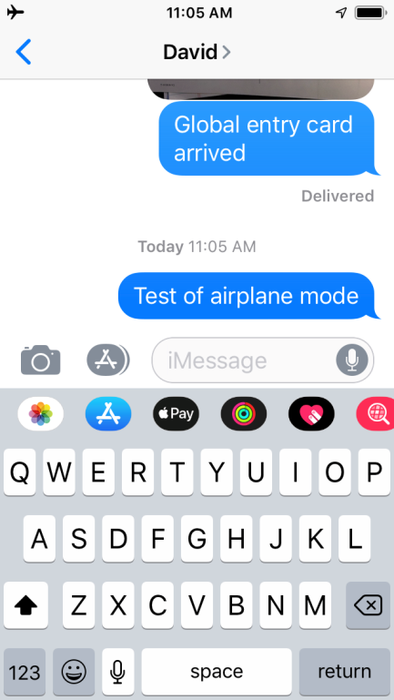
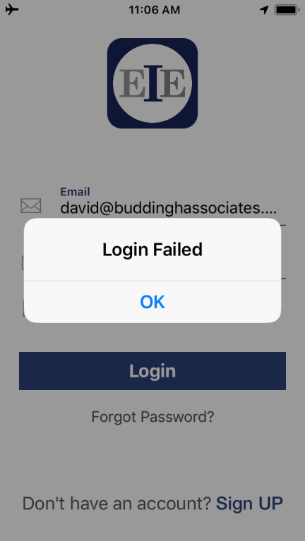
Airplane Mode
What’s App
iMessage
EIE Legal

Slide 38
Can a lawyer ethically use cloud based technology in Florida?
Ensuring that the online data storage provider has an enforceable obligation to preserve confidentiality and security, and that the provider will notify the lawyer if served with process requiring the production of client information;
Investigating the online data storage provider’s security measures, policies, recoverability methods, and other procedures to determine if they are adequate under the circumstances;
Employing available technology to guard against reasonably foreseeable attempts to infiltrate the data that is stored Florida Bar Ethics Opinion 12-3

Slide 39
Ephemeral Platforms
Seem like the solution – no record, nothing to hack.
But…
Not favored by Department of Justice Regulators fcpablog.com
Uber/Waymo
IP theft
$245 million settlement
Source: Wired
Missouri Former Governor Greitens
FOIA and state laws/regulations
Source: Kansas City Star

Slide 40
Ephemeral Platforms
Problem: no record, no proof
Existing messaging apps don’t create an archived record of conversations – leaving firms exposed to liability.

Slide 41
Preserve Communications
Necessary to document every communication to properly represent the client.
Unalterable record: best practice limiting liability from potential misconduct accusation.

Slide 42
Third Party Help
Lawyers are generally not technology experts
But ethical obligations still apply

Slide 43
Model Rule 5.3 Responsibilities Regarding Nonlawyer Assistance
What questions should lawyers ask their potential vendors when it comes to messaging and encryption or due diligence consideration.
Reference checks and review of vendor credentials.
Vendor’s security policies and protocols.
Vendor’s hiring practices.
The use of confidentiality agreements.
Vendor’s conflicts check system to screen for adversity.
The availability of legal redress. Model Rule 5.3

Slide 44
Florida Standard
Investigating the online data storage provider’s security measures, policies, recoverability methods, and other procedures to determine if they are adequate under the circumstances;
Florida Bar Ethics Opinion 12-3

Slide 45
What Do You Need?
A communications platform that is:
Transparent
Instant
Secure
Unalterable

Slide 46
What is EIE Legal?
EIE Legal is a secure mobile messaging app for lawyers that puts encrypted transparency in the palm of their hands.

Slide 47
What is EIE Legal?
Most importantly, it’s a solution to a problem lawyers and clients face every day:
Clients want to communicate as easily with their lawyer as they do with everyone else – through a messaging app.
But, existing messaging options do not meet the necessary legal standards, putting both lawyers and clients at risk.
Lawyers can protect their privacy by not giving out their cell phone but still be accessible.

Slide 48
Beyond Traditional Messaging
As a lawyer, your communications with clients need to be secure and recorded for the future.
Our service encrypts not only your conversation but also any PDFS, notes, photos, or other documents. Then, it stores the conversations until the user archives them.
The archived record can be “printed” out and retained in hard copy files or moved to electronic storage (i.e. cloud). Both preserve evidence of the conversation.
EIE Legal app goes beyond end-to-end encryption – users’ information and communications are always encrypted and can never be accessed by our servers.

Slide 49
EIE Legal App Features
Quick, convenient messaging system that meets lawyers’ security needs
“Encrypted Transparency”TM: Archived record of communications to retain for their files and option to “print” communications
Text messages
Notes
Photos
Videos
Microsoft Office documents
PDF documents
In addition, the app stores them until the user deletes them, when a record is made for safekeeping.

Slide 50
Encrypted TransparencyTM
EIE Legal automatically creates a record of every conversation so users will never be in jeopardy of losing information or evidence in a text.
That provides the firm with the security it needs to face future challenges from clients and protect themselves from costly lawsuits.

Slide 51
Communication Record Options
When the conversation has been completed all parties involved will receive an encrypted archive of the discussion on their phones. Allowing you to protect yourself with “Encrypted Transparency”TM.
Each party then has four options:
KEEP the archived encrypted conversation on in their cloud based account for as long as they choose.
PRINT the archived conversation to a wireless printer. The document will become unencrypted at the point of printing.
STORE the conversation electronically. I.E. save to One Drive cloud or send to a file folder.
DELETE the archived conversation completely, retaining no personal record of the conversation on their own phone. This does not mean the other parties’ copies will be deleted.

Slide 52
Tracking Your Communications
​Our team can never access any of your communications due to the encryption process EIE Legal.
You will immediately receive a notification if a contact took a screenshot of the conversation.

Slide 53
Selective Accessibility
Securely engage your clients on your terms
Your clients have access to you always and securely
But they don't have your cell phone number
That means you (the lawyer) can choose how and when to respond to your portion of the 2.27 trillion texts sent every year.

Slide 54
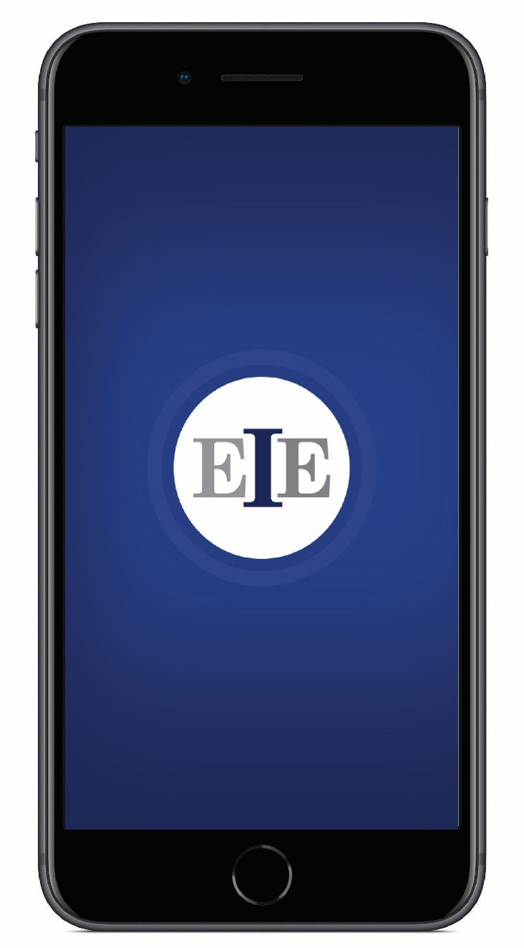
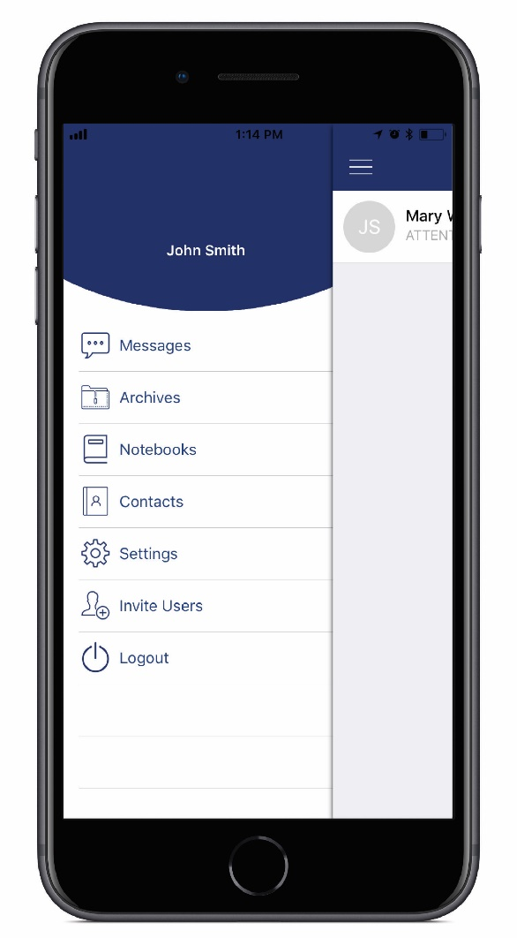
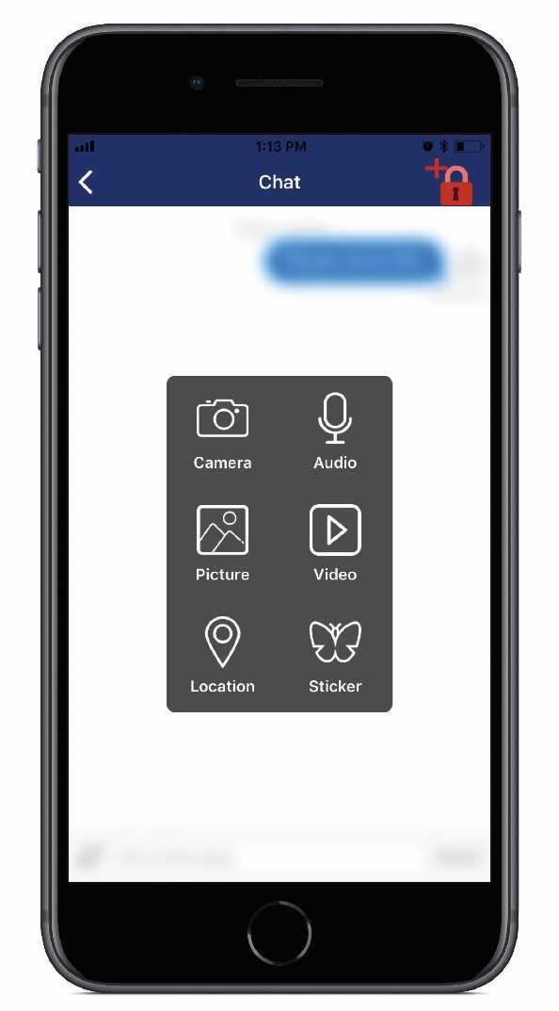

Slide 55
Contact Us
Custom encryption services and app development available for your law firm.
Contact us at: Info@EncryptedInfoEx.com
Or dmbuddingh@encryptedinfoEx.com

Slide 56
COURSE #3596
Legal EIE: Encrypted Messaging App for Law Firms.
Always Secure. Always Transparent. Always Recorded.

